Slide 1

3D Vision LLM
3D OBJECT CAPTIONING - WEEK #3
8-8-2024
Submitted by:
Mr. FAZZA Abdellah - ENSAM Casablanca (Big Data & IoT)
3D SMART FACTORY

Slide 2

Plan
Overview
Proposed Optimization Strategies
Proposed Architecture #1
Dataset
Proposed Architecture #2
Rendering
Comparative Analysis
2

Slide 3
Overview
In my proposed methodology, I’ve suggested two model architectures: a supervised learning-based architecture and a pipeline using pretrained models. I dove deep into both approaches and compared them in various aspects. This presentation shows the results of that comparison.
--Spoiler: I decided to go with the pretrained pipeline approach--
Additionally, I present some optimization strategies for the chosen architecture. I plan to try different techniques, compare their impacts, and ensure I'm not sacrificing too much quality for performance.
Lastly, I found and experimented with a rendering script to produce 2D images from the given 3D object.
3

Slide 4
Proposed Architecture #1: End-to-End Training
Steps
Data Preparation:
Gather a dataset containing 3D models and corresponding textual descriptions.
Preprocess the 3D models and text data for training and validation:
Preprocess the 3D data (e.g., normalize, center, scale) and ensure it’s in a consistent format (e.g., OBJ, PLY).
Tokenize and preprocess the text descriptions.
4

Slide 5
Proposed Architecture #1: End-to-End Training
Steps
2. Model Input:
Define how the 3D model data will be input into the model: voxel grids, point clouds, or mesh representations.
Decide on how much of the initial text description to provide.
5

Slide 6
Proposed Architecture #1: End-to-End Training
Steps
3. 3D Feature Extraction:
Extract relevant features from the 3D model using a suitable neural network architecture (e.g. 3D CNN), or a pretrained model (e.g. PointNet).
Output a fixed-size feature vector for each 3D object.
6

Slide 7
Proposed Architecture #1: End-to-End Training
Steps
4. Text Generation and Integration:
Select a language model architecture (e.g., Transformer, LSTM).
Modify the model to accept both text input and 3D feature vectors to guide the language model in generating relevant text:
Concatenation: Concatenate 3D features with the text embeddings.
Attention Mechanism: Use an attention layer to focus on specific 3D features while generating text.
7

Slide 8
Proposed Architecture #1: End-to-End Training
Steps
5. Loss Calculation:
Compare the generated text with the actual description.
Calculate the loss (e.g., cross-entropy loss) based on the differences.
8

Slide 9
Proposed Architecture #1: End-to-End Training
Steps
6. Backpropagation and Optimization:
Gradient Calculation: Compute gradients based on the loss.
Parameter Update: Update the model parameters using an optimizer (e.g., Adam, SGD).
9

Slide 10
Proposed Architecture #1: End-to-End Training
Advantages
Direct 3D-to-text learning: The model learns to understand 3D structures directly, potentially capturing spatial relationships more accurately.
Efficiency during inference: Once trained, the model can generate captions directly from 3D data without intermediate steps.
End-to-end training: The entire process can be optimized jointly, potentially leading to better overall performance.
10

Slide 11
Proposed Architecture #1: End-to-End Training
Drawbacks
Complexity in 3D feature extraction: Effectively encoding 3D information is challenging and may require sophisticated architectures.
Computationally Intensive: Training the model from scratch can be computationally expensive and time-consuming.
Generalization: Might struggle to generalize well to unseen objects if the training data is not diverse enough.
Data Requirements: Requires a large and well-annotated 3D-text dataset for training, which might be hard to obtain.
11

Slide 12
Proposed Architecture #2: Multi-Stage Pipeline with Pretrained Models
Steps
Rendering: Render 2D images from multiple camera angles/viewpoints.
Image Captioning: Generate multiple captions for each rendered image using an image-text model (e.g. BLIP).
Caption Selection: For each image and its set of captions:
Encode the image using an image encoder (e.g. CLIP).
Encode each caption using a text encoder (e.g. CLIP).
Calculate similarity scores between image and caption embeddings.
Select the caption with the highest similarity score.
Caption Fusion: Generate a single coherent caption using a LLM (e.g. GPT-2) for the selected captions from the previous step.
N.B. This approach is inspired from the research paper: Scalable 3D Captioning with Pretrained Models.
12

Slide 13
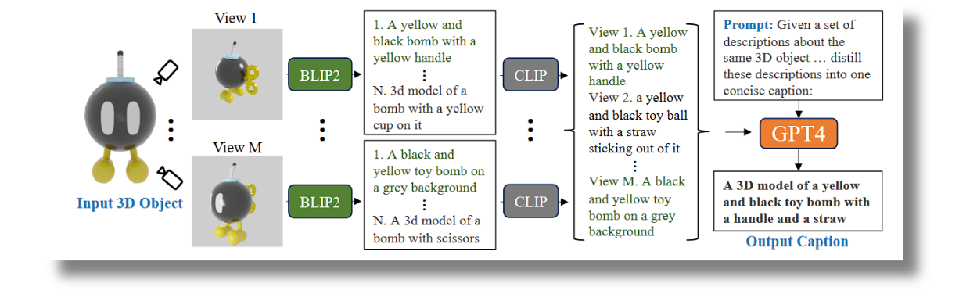
Proposed Architecture #2: Multi-Stage Pipeline with Pretrained Models
Steps (illustrated)
13

Slide 14
Proposed Architecture #2: Multi-Stage Pipeline with Pretrained Models
Advantages
Leverages pre-trained models: Utilizes powerful, pre-trained models like BLIP2, CLIP, and GPT4, benefiting from their broad knowledge and capabilities.
Multi-view understanding: By rendering multiple views, it can capture different aspects of the 3D object.
Flexibility: No need for training, captions are generated on the fly.
Reduced need for 3D-specific training data: Relies more on 2D image-text pairs, which are more abundant.
Robustness: The multi-step process might be more robust to unusual or complex 3D objects.
14

Slide 15
Proposed Architecture #2: Multi-Stage Pipeline with Pretrained Models
Drawbacks
Complexity in pipeline: More steps mean more potential points of failure or error accumulation.
Computational cost: Rendering multiple views and running several large models can be computationally expensive.
Loss of 3D information: Converting to 2D views might lose some spatial information that direct 3D processing could capture.
Dependency on view selection: The quality of the final caption heavily depends on the chosen rendered views.
15

Slide 16
Comparative Analysis
Data Requirements:
Supervised approach needs paired 3D-text data, which is harder to obtain.
Pipeline approach requires no training data.
3D Understanding:
Supervised approach has the potential for deeper 3D understanding.
Pipeline approach might miss some 3D-specific features due to the 2D rendering step.
Generalization:
Pipeline approach might generalize better to unseen objects due to pre-trained models.
Supervised approach could struggle with generalization if the 3D-text dataset is limited.
16

Slide 17



Comparative Analysis
Computational Resources:
Supervised approach might be more efficient during inference but resource-intense during training.
Pipeline approach could be more computationally intensive during inference.
Flexibility and Upgradability:
Pipeline approach is more modular and easier to upgrade individual components.
Supervised approach requires retraining the entire model for significant improvements.
Selected Approach?
Multi-Stage Pipeline with Pretrained Models!
BUT requires optimization to overcome some of the drawbacks.
17

Slide 18




Proposed Optimization Strategies
Model Substitution
Quantization
Using Less Resource-Demanding Models.
GPT-2
CLIP-vit-base-patch32
Lightweight image captioning model
Apply 8-bit or 4-bit quantization to all models to reduce their size and increase inference speed (e.g. post-training quantization).
Suggestions
Pipeline Modification
Rendering Optimization
Skip the captions ranking step and go directly from image captioning to the language model.
Use a single multi-modal model that can handle both image understanding and text generation.
Reduce the number of rendered views or their resolution and quality.
Use efficient rendering techniques like depth-based rendering.
18

Slide 19
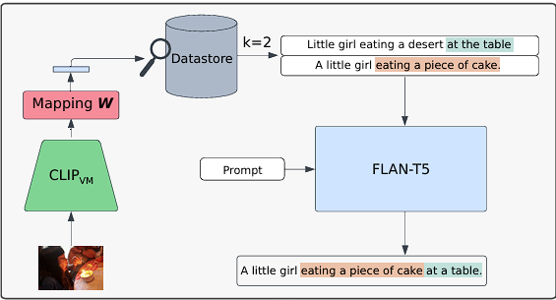
Proposed Optimization Strategies
Pipeline Modification: Retrieval-augmented Image Captioning
Linear Alignment of Vision-language Models for Image Captioning
19

Slide 20



3D-FUTURE: 3D Furniture shape
ABO
Dataset
The 3D-FUTURE dataset is a richly-annotated, large-scale repository of 3D furniture shapes with high-resolution textures and detailed geometries,
The Amazon Berkeley Objects (ABO) dataset is a large-scale collection of product images, metadata, and artist-created 3D models with complex geometries and materials.
Cap3D
Objaverse
Objaverse 1.0 is a large-scale dataset of over 800,000 3D models with captions, tags, and animations, designed to improve upon current 3D repositories.
3D-text pairs generated by Cap3D from the paper: Scalable 3D Captioning with Pretrained Models
Datasets
ShapeNet
ModelNet
ShapeNet is a richly-annotated, large-scale repository of over 3,000,000 3D CAD models organized into 3,135 categories under the WordNet taxonomy, featuring semantic annotations like alignments, parts, symmetry planes, and physical sizes.
offers a comprehensive, clean collection of 3D CAD models for objects, organized into common categories derived from the SUN database, with human-verified categorization and alignment.
20

Slide 21

Rendering: Render a set of 2D views for each 3D object
“We render using Blender at 512×512 from M = 8 high-information camera angles rotating horizontally around the object, with two slightly below and the rest slightly above the object, to cover all the object details. The reason we prefer multiple views is a forward-facing view may miss self-occluded object details or face strange appearance and/or lighting. In contrast, multiple views will see much of the object from different viewpoints, increasing the number of chances for a captioning model to predict objects in detail”.
Scalable 3D Captioning with Pretrained Models: Tiange Lu and Chris Rockwell
(Section 3.1)
21

Slide 22






Rendering: Render a set of 2D views for each 3D object
Script Break-down (so far)
Helper Functions
Setup and Initialization
Normalize and center the object. Position camera based on the object's size. Render object from 8 different viewpoints
Blender Configuration
Import necessary libraries.
Load 3D object file paths.
Set up Blender to use the Cycles render engine and configure it to use GPU.
Main Rendering Loop
Scene Preparation
Output Directory Setup
create a consistent set of renderings for each object from multiple angles.
Delete default cube.
A three-point lighting setup is created.
Store rendered images and camera matrices.
22

Slide 23
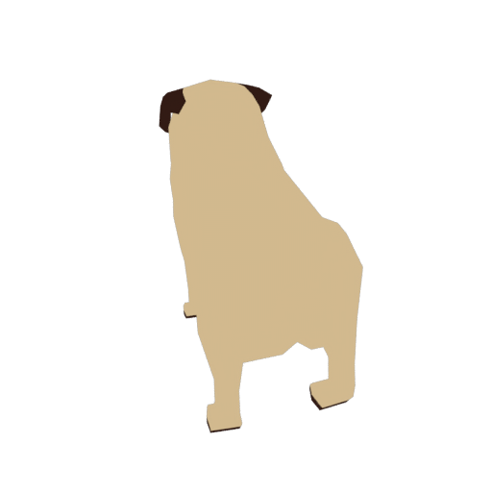



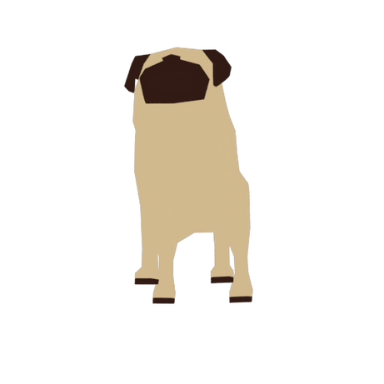



Rendering: Render a set of 2D views for each 3D object
Example: Rendered 2D images of a 3D object
23

Slide 24

Thank You
for your attention

